Slide 1



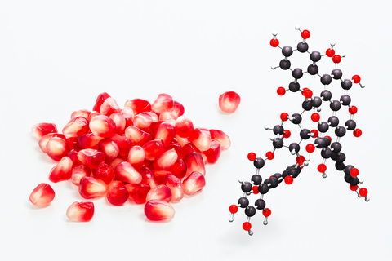


COST Action FA 1403 – POSITIVe
Interindividual variation in response to consumption of plant food bioactives and determinants involved
MAIN OBJECTIVE
Build an open European scientific network to tackle the question of interindividual variation in response to food bioactives consumption
WORKING GROUPS
WG1: Interindividual variation in bioavailability
WG2: Interindividul variation in the biological responsivenessregarding cardiometabolic endpoints
WG3: From emerging science to applications
Focus Group: Communication and dissemination
www6.inra.fr/cost-positive

Slide 2












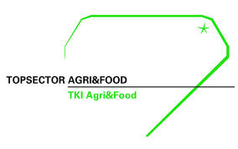

































































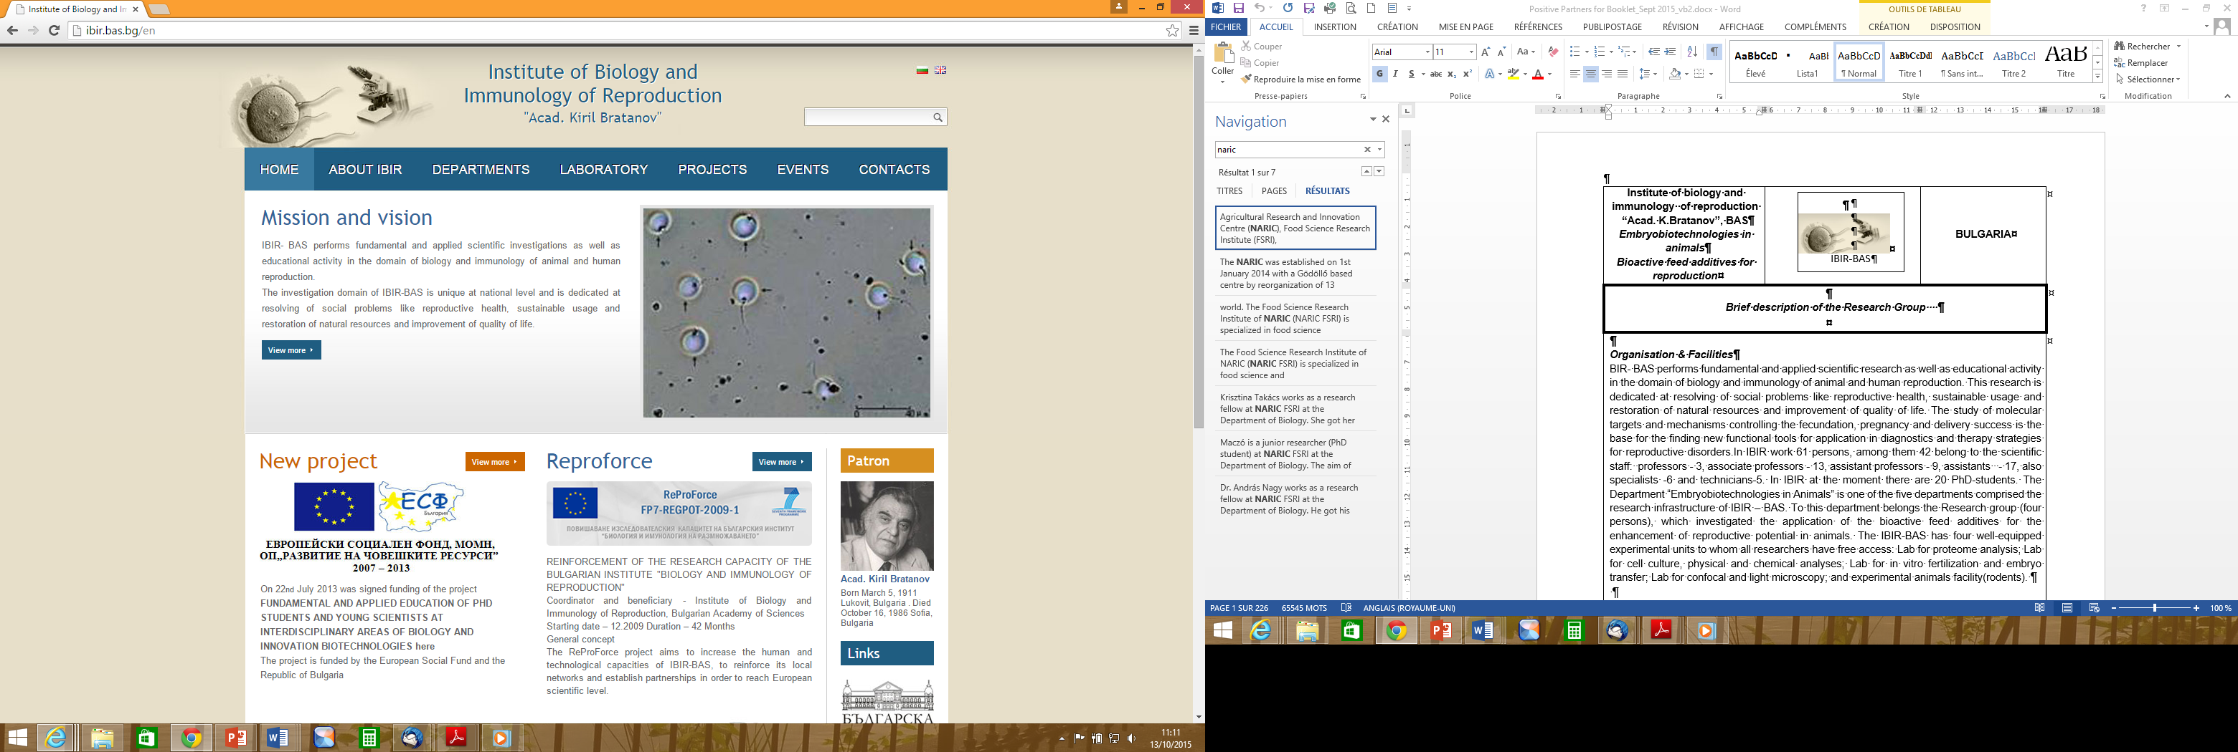









































POSITIVe Network
>70 Research Institutions
7 National Federations Food & Drink
32 countries
Notes:
THE POSITIVE NETWORK INVOLVES :
MORE THAN SEVENTY RESEARCH INSTITUTIONS,
AND 7 NATIONAL FEDERATIONS OF THE AGRO-FOOD SECTOR, REPRESENTING SMES.
ALL THESE MEMBERS COME FROM THIRTY ONE COST NATIONS ACROSS EUROPE.

Slide 3


EXPECTED IMPACTS
SCIENCE
Strengthen and structure a large European community to ensure future innovative research on plant bioactives and cardiometabolic health
Improve evaluation of the health benefits of plant food bioactives taking into account different subgroups of responders
Train Early Stage Researchers (ESRs) in the field and develop their capacity building through exposure to multi-disciplinary and multi-sectorial questions
INDUSTRY
Provide scientific basis for future innovative spin-off projects
Support development of new functional/customized foods
Increase European Agro-food industry competitiveness
PUBLIC HEALTH
Provide scientific basis to refine dietary recommandations to optimized the health effects of plant foods for all population subgroups
Help public authorities in refining global strategies regarding nutrition to improve lifelong health and well-being of the European population
www6.inra.fr/cost-positive

Slide 4



THEMATIC TRAINING COURSES
Multidisciplinary training courses in areas relevant to the primary objectives of POSITIVe. The courses are mainly directed to ESR with the aims of: enhancing their knowledge on inderindiv. Variation in response to the intake of plant bioactives and factors involved, ii) developing their leadership skills for future Europan centres.
SHORT-TERM SCIENTIFIC MISSIONS
Exchange visits between researchers involved in POSITIVe aimd at supporting scientists to visit an istitution in another partner country, strenghtening the existing cooperation, promoting development, learning new techniques, etc. STSMs are intended especially for young people
COST FA 1403 – POSITIVe
Interindividual variation in response to consumption of plant food bioactives and determinants involved
Action Chair: Dr. Christine Morand, INRA-France
Action Vice-Chair: Prof. Francisco Tomas-Barberan, CEBAS-SCIS, Spain
www6.inra.fr/cost-positive

